Slide 1
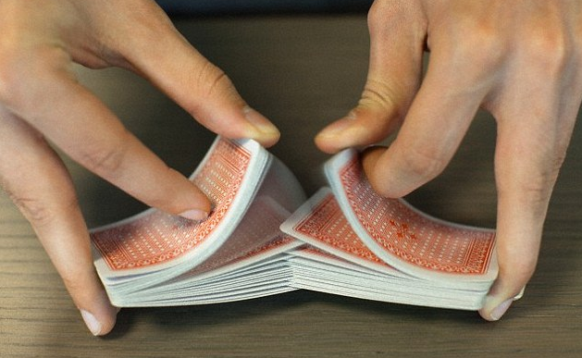
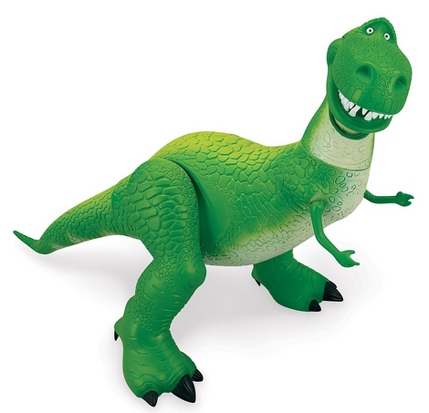



Self Calibrating Detectors
Project Status ( NOT a pitch ! )
https://totem.west.ile.nga.ic.gov/briefs.view
Brian.d.james@coe.ic.gov
SEPP Machine Learning

Slide 2
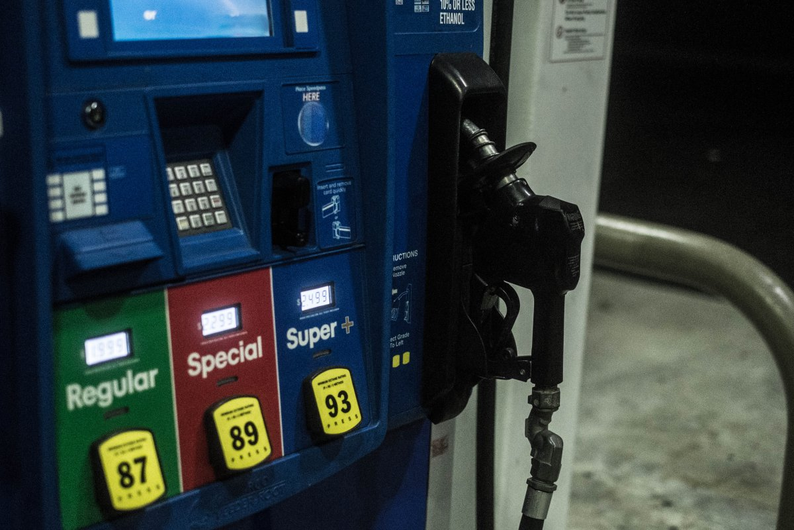
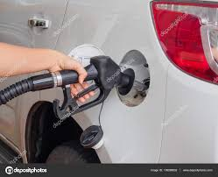




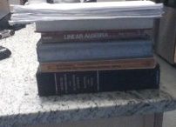
Fuel of unknown quality being pumped into hypothesis engines.
Event Providers (xyzt)
ADSB Airtrack
Overhead IR
ITAR Transactions
Voxel
Engine Providers
THRESHER
RGBW Crack Detector
?
?
?
COGNOS
Forecasts
BAH + ICR INC
$$ = 12 HHEADS
BLITZ USER BASE
TOTEM
Metrics
SNR
% Complete
Est Time to Complete
Relevance
TOTEM
Forecasts
Arrival Rate
Trigger Function
FREE
R&D ONLY
Metric Providers
Prof. Mandel, Wilson’s Chair Physic, RIT
Prof. Wolf, Lee DuBridges Chair Physics, RIT
Prof. Frieden, Optical Sci Chair, UofAz
Prof. Goodman, EE Chair, Stanford

Slide 3
Reserved for map sample

Slide 4

Supervised ? Unsupervised ?
SEPP
Hidden states
x, y, z, t, state
x, y, z, t
Black Body Calibrated
Self Calibrating Detector
Supervised Learning
Unsupervised Learning

Slide 5
Quiz !
I texted the following to my Wife, my Son, and a Friend ….
Eureka ! I got my Levenberg Marquardt to compute the
correlation times of a Markov process,
thus bypassing a hopeless Linear Factor Analysis that would attempt to
maximizes a Chi^2 fit of a
negative binomial with a differentated Gamma function.
The correct response pattern was RGB ?
I like cheese | Wife | F | S
You misspelled differentiated | Son | S | W
I avoid all that negativity by using positive binomials | Friend | W | F

Slide 6
Self Calibrating Detectors
SEPP Machine Learning

Slide 7
 | 1950 - 1990 Self Calibrated Detectors | Now 1990 – 2000 Machine Learning
Metrics | Levenberg Marquardt SNR % Complete ETC
Forecasts | Karhunen Loeve Arrival Rate | EM Arrival Rate Space-Time Trigger Function
 | Paley Weiner Trigger Function Viterbi Decoding Brownian Motion

Slide 8

Some Physics of Self Calibrating Detectors
… via a cheap parlor trick
thus all machine learners

Slide 9
Are They Related ?
y
x

Slide 10
Still Related ?
Trade
Deficit
National Debt

Slide 11
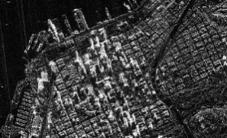
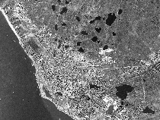
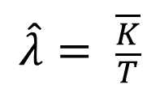
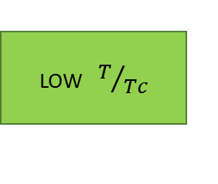
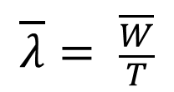
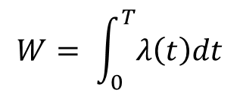
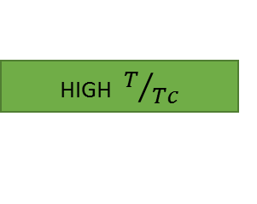
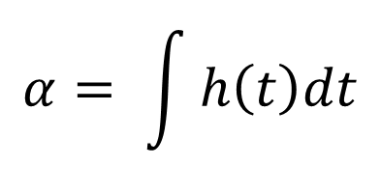
Still Related ??
Output
Observed
LOW $T/{Tc}$
HIGH $T/{Tc}$
High
SNR
$$\hat{λ}= \frac{\overline{K}}{T}$$
K = Observed
Counts
LOW
SNR
$$α= \int{h\left(t\right)dt}$$
S.F.I.
$$\overline{λ}= \frac{\overline{W}}{T}$$
Input
Forecasted
$$W= \int_{0}^{T}{λ\left(t\right)dt}$$
Integrated Intensity

Slide 12
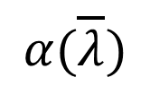
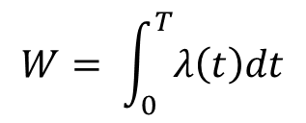
Still Related ???
Output
P.O.L.
$$α(\overline{λ})$$
POL
WSS
SFI
$$\hat{λ}= \frac{\overline{K}}{T}$$
Ergodic
SS
K = Observed
Counts
$$α= \int{h\left(t\right)dt}$$
S.F.I.
$$\overline{λ}= \frac{\overline{W}}{T}$$
Input
$$W= \int_{0}^{T}{λ\left(t\right)dt}$$
Integrated Intensity

Slide 13
h(t)
h(t,x)
The Trigger Function
Quantum Computing

Slide 14
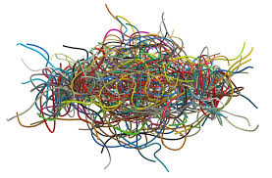

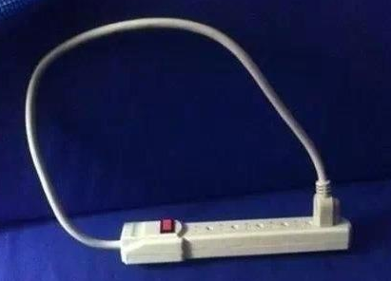
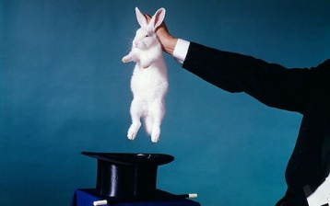
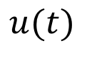
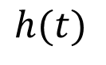
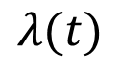
Unknown Trigger
Threshold &
Peak Rate
Circuit
∞ Parameters
Unknown
Arrival Rate
“Uncountable”
count process
$$λ(t)$$
$$h(t)$$
$$u(t)$$
Positive Definite
Always ? Why ?
Infinite power in PSD so
… no Nyquist cutoff
… cant be sampled
… but it can be Fourier transformed !

Slide 15
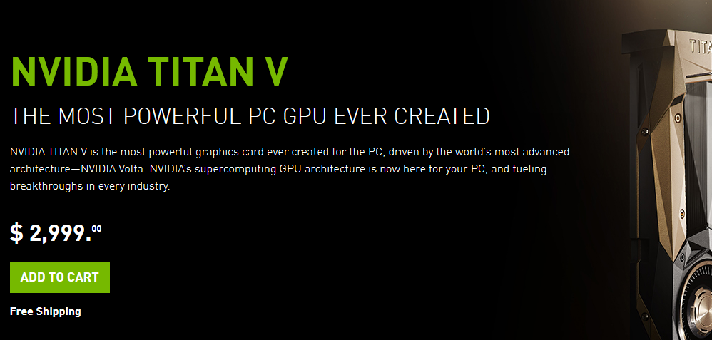
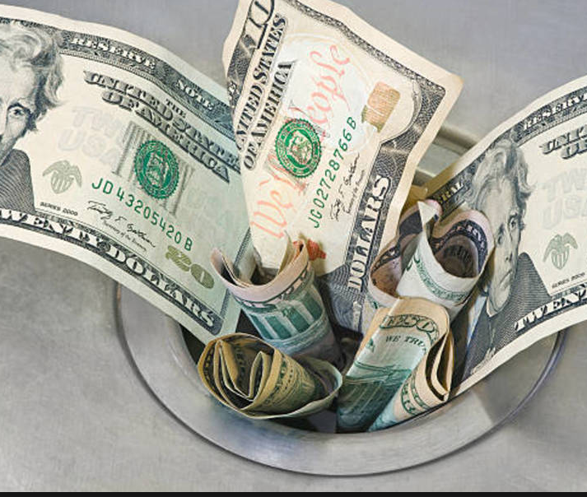


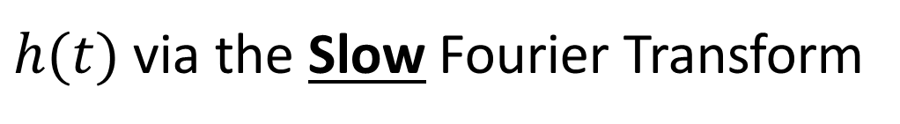
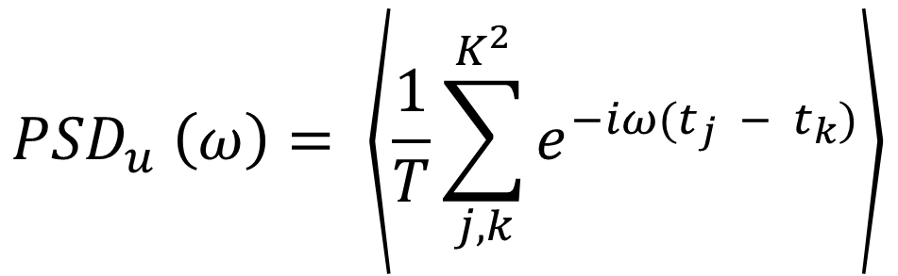
Hi
$h(t)$ via the Slow Fourier Transform
You again
$${PSD}_{u} \left(ω\right)= \left\langle \frac{1}{T}\sum_{j,k}^{K^{2}}{e^{−iω(t_{j} − t_{k})}}\right\rangle$$
PWT
This is the “DNN” we need to learn
Unsupervised Learner … but needs “unique events ids”
Slooooow FT ➔ Faster FT when GPU-ized

Slide 16
GPU-ized Machine Learning
.. some known side effects

Slide 17

Over the last 10 years …
Total energy to run
410 Million GPUs (500 W = 40 $/mth each)
= 2 Trillion USD
= 50% of GDP growth
= 20% of bad Private Sector debt
= 20 x Internet 1.0 Bubble
= cost to feed and house 20 M people
Ref: next slide

Slide 18
h(t)
h(t,x)
P(voxel, voxel)
Training voxel networks
to learn
hidden Markov parameters
of a Brownian motion

Slide 19
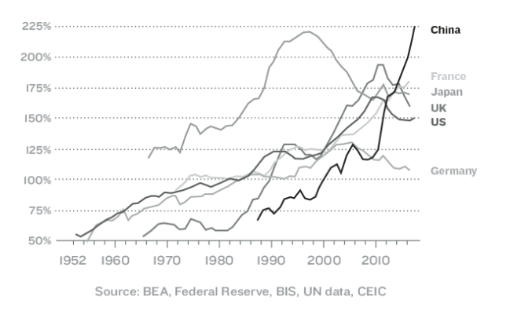
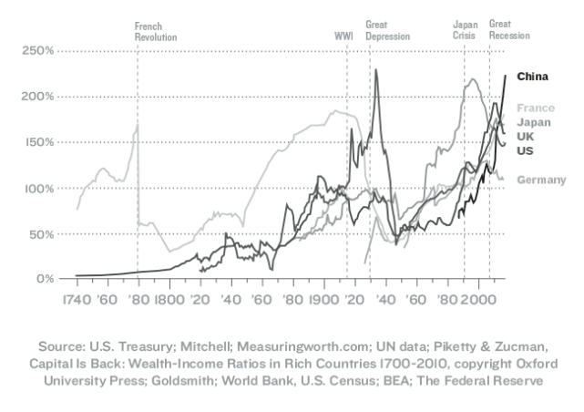


Private Sector Debt to GDP
Google/R - Carnegie Mellon
Revisiting Unreasonable
Effectiveness in the
Deep Learning Era
Internet 1.0
Bubble
2 T USD
Internet 2.0
Bubble
10 T USD
GPU Power Consumption
= 50 % of GDP growth
= 20 % of growth in bad Private Sector debt
over last 10 years

Slide 20
Questions ?

